Slide 1



ZnO Deposition
The Window Layer of a Solar Cell
Nabila Huq, Jin Zhang, and Anthony Muscat
University of Arizona, Department of Chemical and Environmental Engineering
Arizona/NASA Space Grant Undergraduate Research Internship Statewide Symposium
April 21st, 2012
University of Arizona

Slide 2
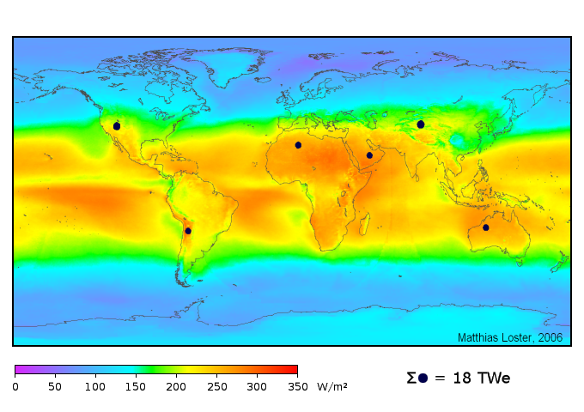
Solar Energy
Advantages
  Most abundant energy source available
  Silent and unobtrusive
  Low adverse emissions
  15-30 year panel life
  Low area usage
Disadvantages
  Expensive to mass-produce thus replace
  Inefficient compared to fossil-fuel sources
  Dependent on weather
Image Source: http://www.ez2c.de/ml/solar_land_area/

Slide 3
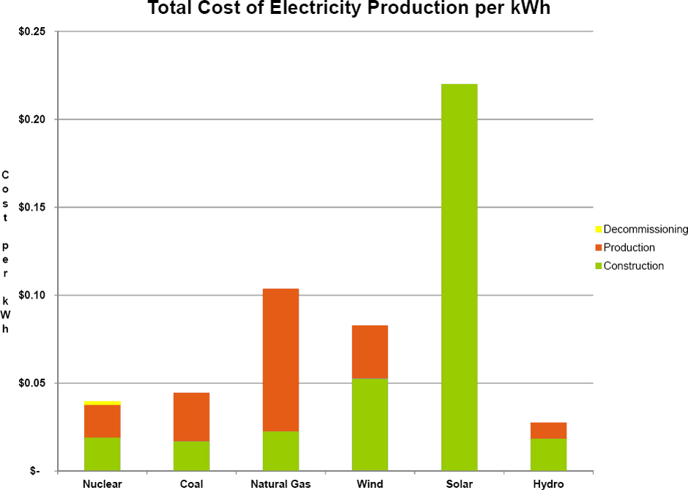
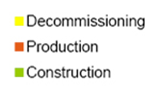
Energy Cost Breakdown
Image Source: http://nuclearfissionary.com/2010/04/02/comparing-energy-costs-of-nuclear-coal-gas-wind-and-solar/

Slide 4
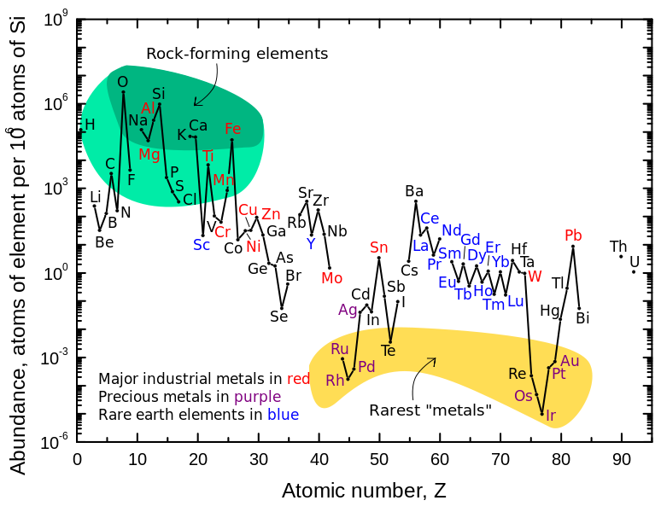
Overall Project Goal
Develop a flexible, low-cost, inorganic solar cell using:
          Inexpensive, fast deposition methods
          Methods feasible for large-scale manufacture
          Earth’s abundant materials
Image Source: http://pubs.usgs.gov/fs/2002/fs087-02/

Slide 5
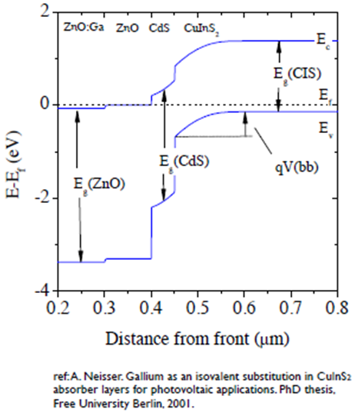
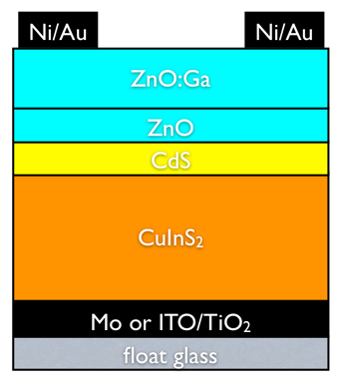
CIS Solar Cell Layout
Metal Contact
Window Layer
Buffer Layer
Absorber Layer
Substrate

Slide 6
CIS Solar Cell: Window Layer
Function and Features
  Admits light to the junction region and absorber layer
    Thin
    Uniform
    No photocurrent generation occurs in the window layer
  Wide band gap (>2.8 eV)
    Minimal resistive loss
Parameters
  ZnO
    Thickness: 50 nm
    Band Gap: 3.2 eV
  ZnO:Ga
    Low resistivity allows for metal contact
    Thickness: 300 nm
    Band Gap:3.6-3.8 eV

Slide 7
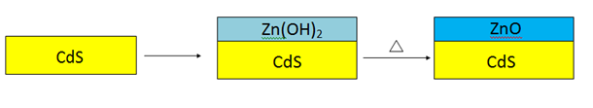
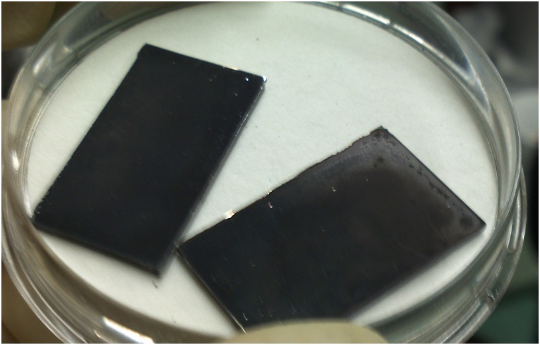
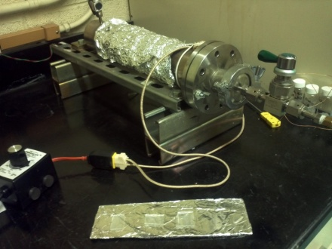
Cleaning
Deposition
After-Treatment
Annealing
Characterization

Slide 8
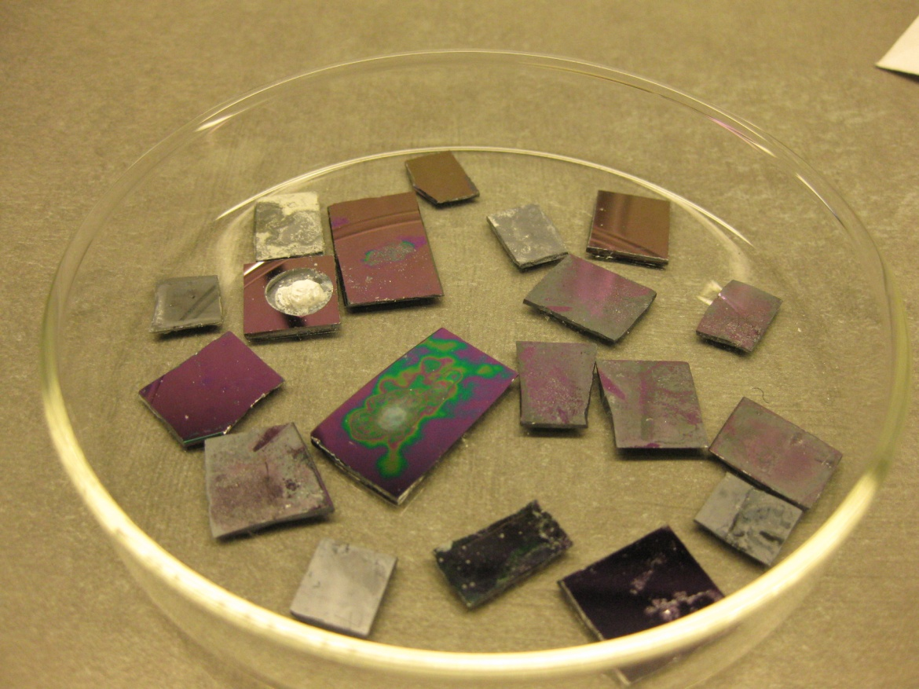
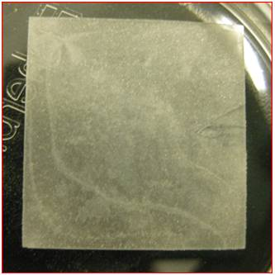
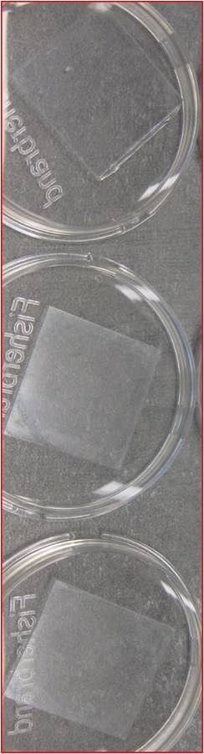
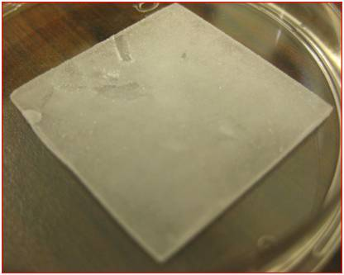
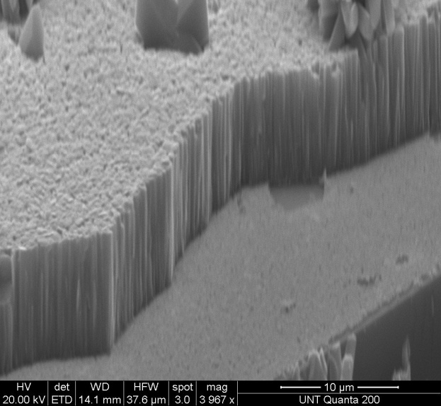
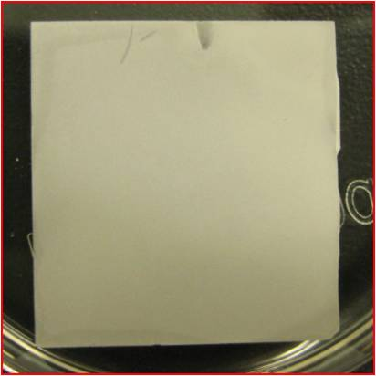
Deposition Methods
Chemical Bath
Spin Coating
1:3 dilution
1:1 dilution
mother solution

Slide 9
Thickness and transparency: strong functions of the concentration
At least 10 minutes in heated solution necessary for deposition
Temperature between 80 °C and 130 °C

Slide 10
SEM of Layer Stack
ZnO
CdS
CuInS₂

Slide 11
Further Considerations
Alternative chemistries
Control pH
Refine experimental design to find optimum thin layer conditions
Test effects of stirring on deposition

Slide 12
Sol-gel deposition of ZnO thin film for application in low-cost solar cells
Jin Zhang, Nabila Huq, Anthony Muscat
Department of Chemical and Environmental Engineering, The University of Arizona, Tucson
Arizona/NASA Space Grant Undergraduate Research Internship Statewide Symposium
April 21st, 2012
University of Arizona

Slide 13


Sol-gel method
A wet-chemical deposition technique in which a colloidal solution (sol) evolves into an integrated network (gel) of discrete particles
Used to fabric materials, usually metal oxides
Low-cost, high chemical homogeneity, uniform distribution of dopants
Integrated network of discrete particles or network polymers (gel)
Colloidal solution precursor (sol)

Slide 14
Existing Methods of ZnO Deposition
Expensive and/or low-throughput techniques
  Sputtering
  Chemical vapor deposition (CVD)
  Pulsed laser deposition (PLD)
  Electrodeposition
  Spray pyrolysis
The sol-gel method is much cheaper and holds potential for large-scale manufacturing of solar cells in the future
Does not require processing in vacuum

Slide 15
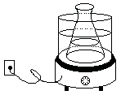
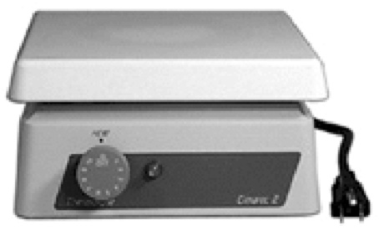
Fabrication Process
Sol-gel precursor solution from zinc acetate dihydrate and monoethanolamine (MEA) dissolved in 2-methoxyethanol, reacted at 60°C for 2 hrs
Hold for at least 2 days
Spin coat deposition
Evaporate excess solvent on hotplate
Anneal at high temperature in ambient air, pure nitrogen, forming gas (95% N₂/H₂) or a combination of the three
Sol-gel hold time
Spin-coating
Solvent Evaporation
High-temperature annealing in furnace

Slide 16
Objectives
Deposit ZnO on scale of 50 nm to 300 nm thick
Obtain band gap close to 3.2 eV using UV/vis
Optimize sol-gel hold time, solvent evaporation temperature, annealing temperature, and annealing environment
Characterize film composition using X-ray photoelectron spectroscopy (XPS)
Image film with SEM

Slide 17
Results
Successfully deposited 20 nm to 60 nm of ZnO with good surface uniformity
Film composition confirmed to be mixture of ZnO and ZnOH with UV/vis and XPS
Obtained band gap of 3.55 eV
Cross-sectional view
Top view

Slide 18
Fabrication Parameters
Optimum conditions
1 month sol-gel aging time
Solvent evaporation at 40-70°C, with gradual temperature increase
Anneal in N₂ at 400°C for 1 hr
Fabrication Problems
Film cracking
Conversion of ZnO to ZnOH
Oxidation of CdS layer during annealing
ZnO/ZnOH = 2.39
Zn-O
Zn-OH

Slide 19
Effect of Annealing Environment
Annealing at high temperatures (500°C- 550°C) in pure nitrogen and ambient air produced films which showed Si under XPS (film cracking)
Annealing at lower temperature (400 °C) in both nitrogen and ambient air produced films which were intact with high ratio of ZnO: ZnOH (2.39)
Annealing in ambient air followed by forming gas (95% N₂/5% H₂) produced film with no cracking but a low ratio of ZnO: ZnOH (0.377)

Slide 20
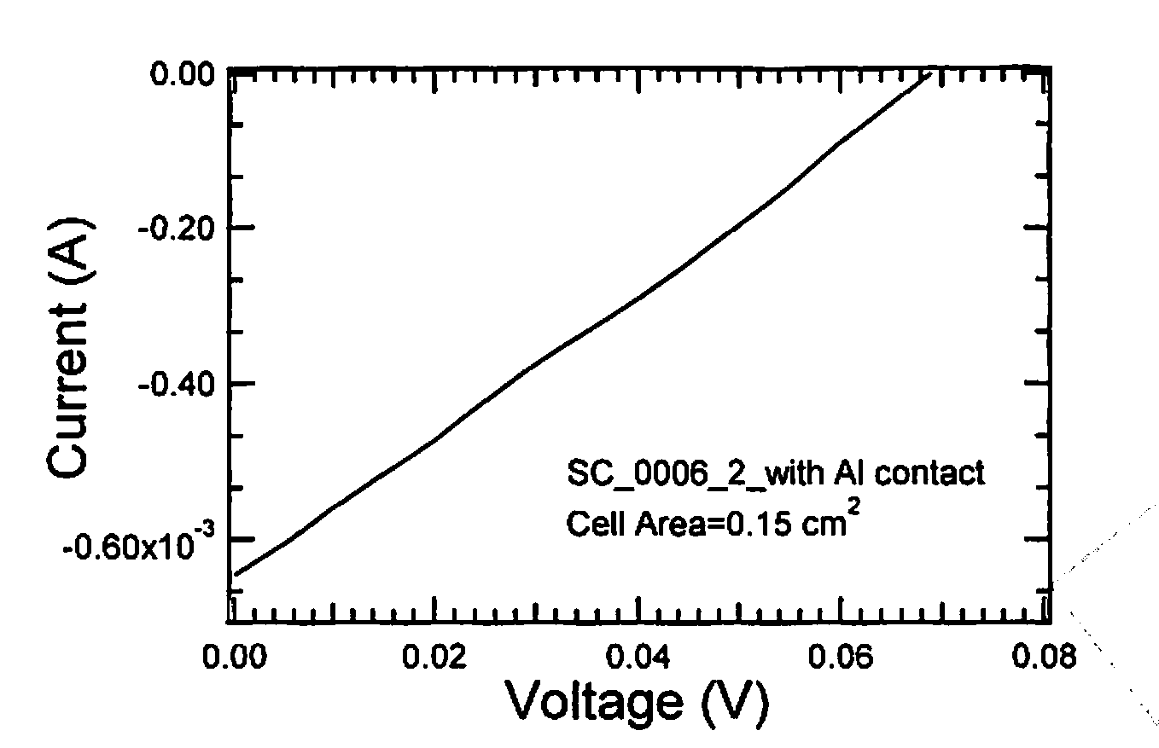
Preliminary Efficiency Results
Under 1.5 air mass for the first working cell with an area of 0.15 cm² yielded an open circuit voltage (V_{oc})of 0.07 V and a short circuit current (J_{sc}) of 4.8 mA/cm²
Fill factor of 0.26 and efficiency of 0.1%
  Shunting from gaps in the CIS absorber
  Thinner than designed CdS layer as shown by scanning electron microscopy images

Slide 21
Future Recommendations
Eliminate use of spin coating for deposition
Optimize solvent evaporation and annealing in oxygen-free environment
Optimize conditions for ZnO doped with Ga
Improve efficiency of completed solar cell

Slide 22
Acknowledgements
We would like to thank the UA/NASA Space Grant and Suntricity for funding and support. We would also like to thank members of the Muscat lab group for their help and support.

Slide 23
Thank you
Questions?

Slide 24
Backup Slides

Slide 25
Band gap and thickness calculations
Beer-Lambert Law
A=ɛlc= αl
Band gap: the energy difference between the top of the valence band and the bottom of the conduction band in insulators and semiconductors

Slide 26
Effect of sol-gel aging on XPS of Oxygen Peak
After spin-coating
After annealing in air at 550 °C, 1 hr
Sol-gel aged for 2 days
Zn-OH
Zn-OH
Zn-O
Zn-O
Sol-gel aged for 10 days
Zn-OH
Zn-O
Zn-O
Zn-OH

Slide 27
Effect of Hotplate Temperature for Solvent Evaporation
All samples annealed at 500 °C in nitrogen for 1 h
Spin coated and solvent evaporated at various temperatures on hotplate
Temperatures higher than 100°C showed signs of Si
100 °C, 3 coats
Zn/O = 0.78
50 °C, 3 coats
Zn/O= 1.69
Zn-OH
Zn-OH
Zn-O
Zn-O

Slide 28
Annealing in air and forming gas
Parameters:
2 day aging
Spin coat 1 layer
Solvent evaporation at 350 °C
Heat in air at 550 °C
Anneal in 95% N₂ /5% H₂ at 500°C
Results:
Zn/O= 1.04
Zn-OH: 27.4%
Zn-O: 72.6%
Band gap = 3.55 eV
Zn-OH
Zn-O

Slide 29
Annealing in air at 550°C
Parameters:
~1 month aging
Spin coat 3000 rpm, 30 s, 1 coat
Solvent evaporation at 350 °C
Anneal in air at 550 °C for 1 h
Results:
Silicon detected
Zn/O=0.52, part of O comes from SiO₂
Zn-OH
Zn-O

Slide 30
Annealing in air at 400°C
Parameters:
3 day aging
Spin coat 3 layers, heated at 350 °C in between
Anneal in air at 400 °C, 1 hr
Results:
Zn/O=1.10
Zn/C=12.5
Zn-O
Zn-OH

Slide 31
Annealing in air at 400°C
Cross-sectional view
Top view

Slide 32
Annealing in pure nitrogen at 400°C
Parameters:
3 day aging
Spin coat 2 coats
Heat at 200 °C between and after coats
Anneal in pure nitrogen at 400°C, 1 h
Results:
Zn/O = 1.20
Zn/C = 3.17

